Slide 1
Min-k%++: Improve Baseline for Detecting Pre-Training Data from LLMs

Slide 2
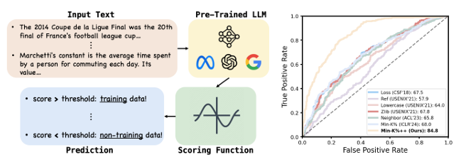
Introduction
LLMs are trained on HUGE amounts of data and trillions of tokens
In this vast dataset, private or proprietary information can be memorized by LLMS - violating the data privacy rights and exposing evaluation data.
Pre Training Data Detection Strategies
Goal: To infer whether a given input has been used to train a target LLM

Slide 3
Min-K%++
Fundamental Question: What characteristics or footprints do training sample exhibit within the model.
Min-K%++ Is Used to examine whether an input token forms a model or has a relatively high probability - in order to detect whether it is a member

Slide 4

Problem Statement
Problem Statement: Pre-training data detection is a subset of MIA. We want to infer whether x is either training data or non-training data
We utilize a scoring function to compute a prediction of whether a piece of information is used to train something or not (computes on every input)
Need to design an appropriate scoring function to best separate training and non-training data

Slide 5
Experiments
Benchmark 1: WikiMIA
Used for pre-training data detection, consisting of texts from Wikipedia events
Groups data into splits according to sentence length
Utilizes paraphrase and verbatim sentences to do detection of membership
Baselines:
Loss method - directly takes the loss as the score for detection
Reference Method - uses an extra LLM as reference to calibrate the likelihood of the input
Zlib and Lowercase - use zlib compression entropy and the likelihood of lowercased text as the reference to calibrate the likelihood, respectively
Neighbor - perturbs the input sentence with masked language models to create “neighbors” and calibrate the loss of the input sentence with the average loss of the neighbor sentence
Min-k% - ) examines the exact token probability and averages a subset of minimum token scores over the input
Metrics:
Detection performance is evaluated with Area Under the Curve - while defining data as positive or negative. Positive means there was training data, negative means it is non-training data.

Slide 6
Results
WikiMIA results: Min-K%++achieves significant improvements over existing methods. Min-K%++is also the best- performing approach on average in all cases
Min-K%+++: This method is consistent across models and input lengths
MIMIR: Challenges of MIMIR:
Differentiating training vs. non-training texts is harder since they come from the same dataset.
Min-K%++ Still Improves Over Existing Methods:
Achieves relative AUROC improvements over Min-K% of +0.5% to +2.8% across Pythia models ranging from 160M to 12B parameters.
Larger models benefit more, suggesting that Min-K%++ scales well with increasing model size.

Slide 7
Ablation Study
Hyperparameter k%k\%k% Sensitivity
Min-K%++ is more stable: Performance varies only 2.7% (82.1% to 84.8%), compared to 4.4% for Min-K%.
Min-K% is more sensitive, meaning it requires careful tuning of k%k\%k% for optimal results.
Robustness of Min-K%++ makes it more practical across different settings without extensive hyperparameter tuning.
Effect of Calibration Factors μ and σ
Using μ (sequence bias adjustment) alone boosts AUROC by +9.3%, while using σ (uncertainty normalization) alone improves it by +7.0%.
Combining both factors achieves the highest performance boost of +16.8%, proving their complementary effects.
Min-K%++’s calibration strategy significantly outperforms using raw log probabilities, confirming its effectiveness.

Slide 8
Conclusions
Novel Approach for Pretraining Data Detection:
Min-K%++ is designed to identify whether a given text was part of an LLM’s pretraining data.
It leverages the insight that training data tends to be local maxima or close to them in the model's probability distribution.
Probability-Based Detection Mechanism:
Evaluates if the input forms a mode or has a high probability under the model’s conditional categorical distribution.
Uses a refined method to assess membership inference with improved robustness.
Consistently Outperforms Baselines:
Achieves superior performance across multiple benchmarks and settings.
Sets a strong baseline for future studies in pretraining data detection.
Impact and Future Research:
Provides both theoretical and empirical insights into membership inference attacks.
Encourages further research into detecting and understanding pretraining data in LLMs.

